Slide 1
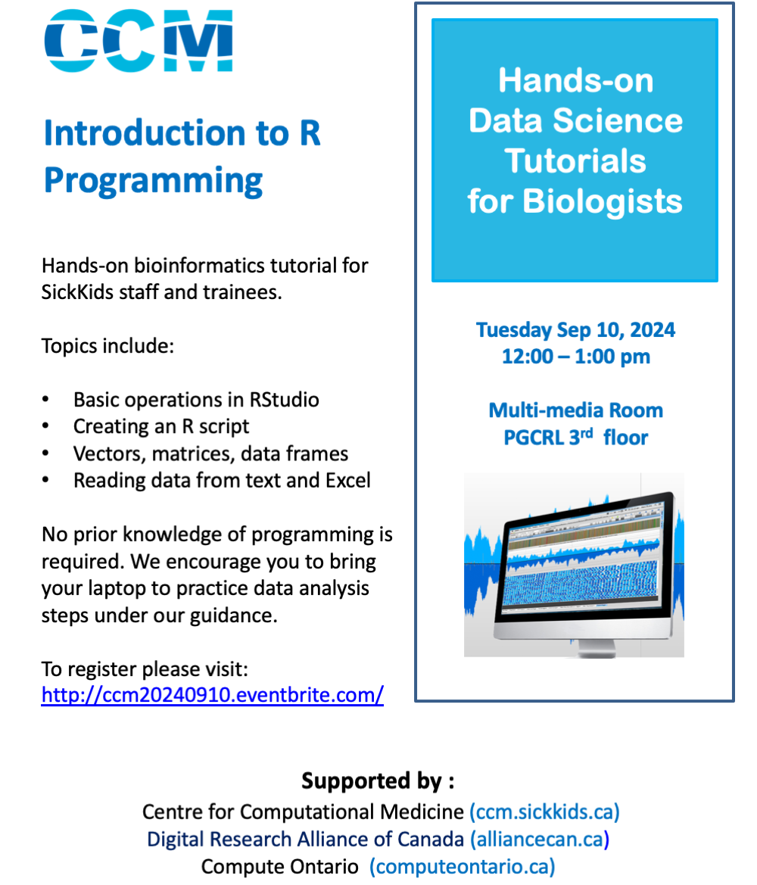
R Programming & Data Analysis
Workshop 1
September 10, 2024

Slide 2



Centre for Computational Medicine (CCM)
Software
& Portals
HPC
Data analysis and grant support
Your Data
CCM
Machine Learning
Tools and pipeline development
Workshops and training
Training
-Omics &
Imaging

Slide 3
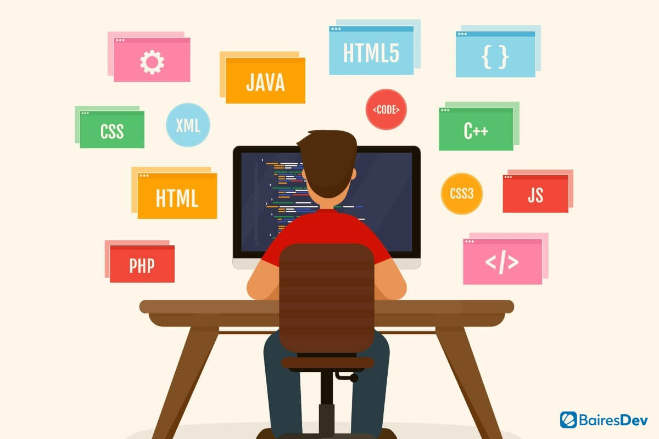
What is programming?
Computers are built on binary code (1’s and 0’s). Programming languages help us “talk” to computers more easily.
Each language has its own syntax/grammar/set of rules and conventions.
Low-level languages are more similar to the binary code whereas high-level languages are more similar to natural language like English.

Slide 4
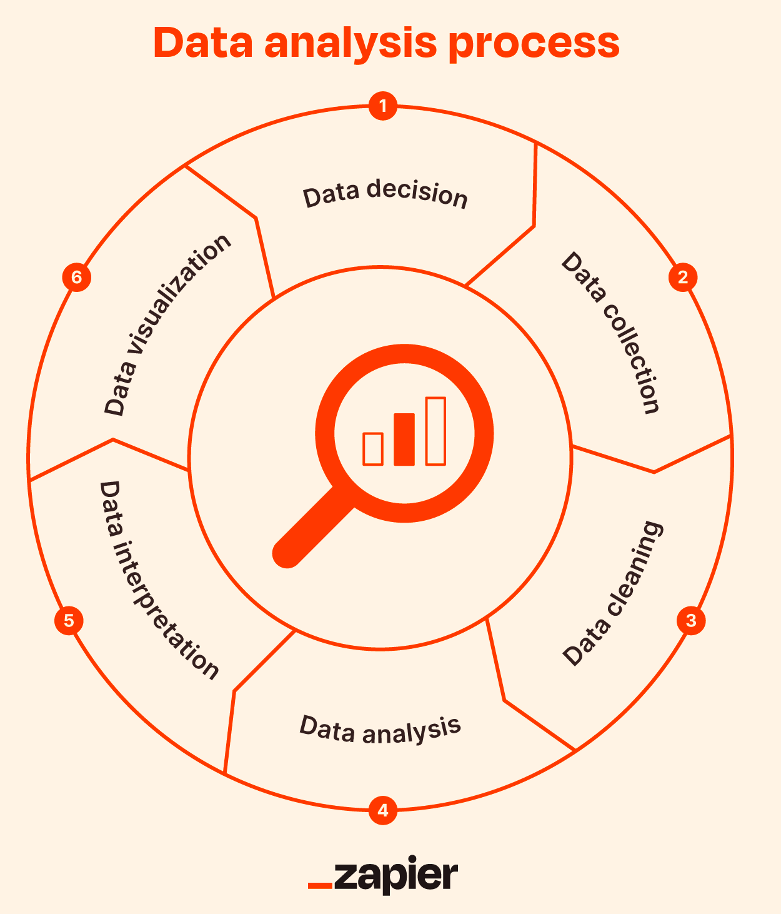
Programming uses (for data analysis)
Too much data to process
Large, complex, diverse data
Reproducible analysis
Self-documenting
Hub of interdisciplinary science
Moving from Excel to AI

Slide 5

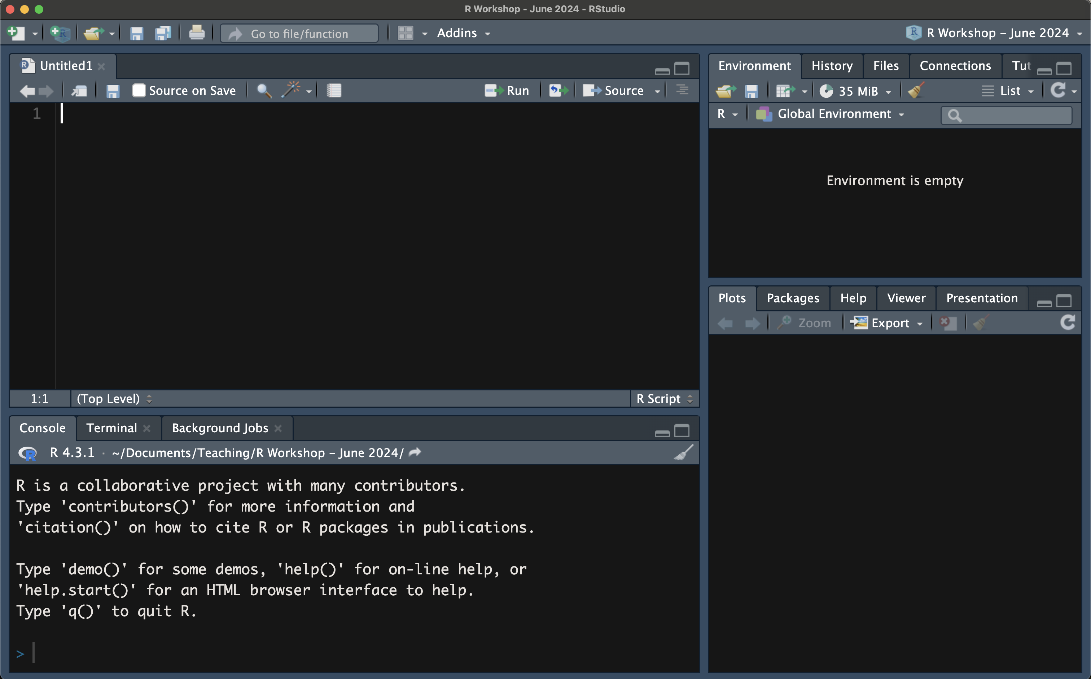
script/editor
environment
console
viewer etc.

Slide 6

script/editor
install + load packages
perform operations, create variables, create objects
write functions, loops
import and export data
data exploration, cleaning, analysis, and visualization

Slide 7
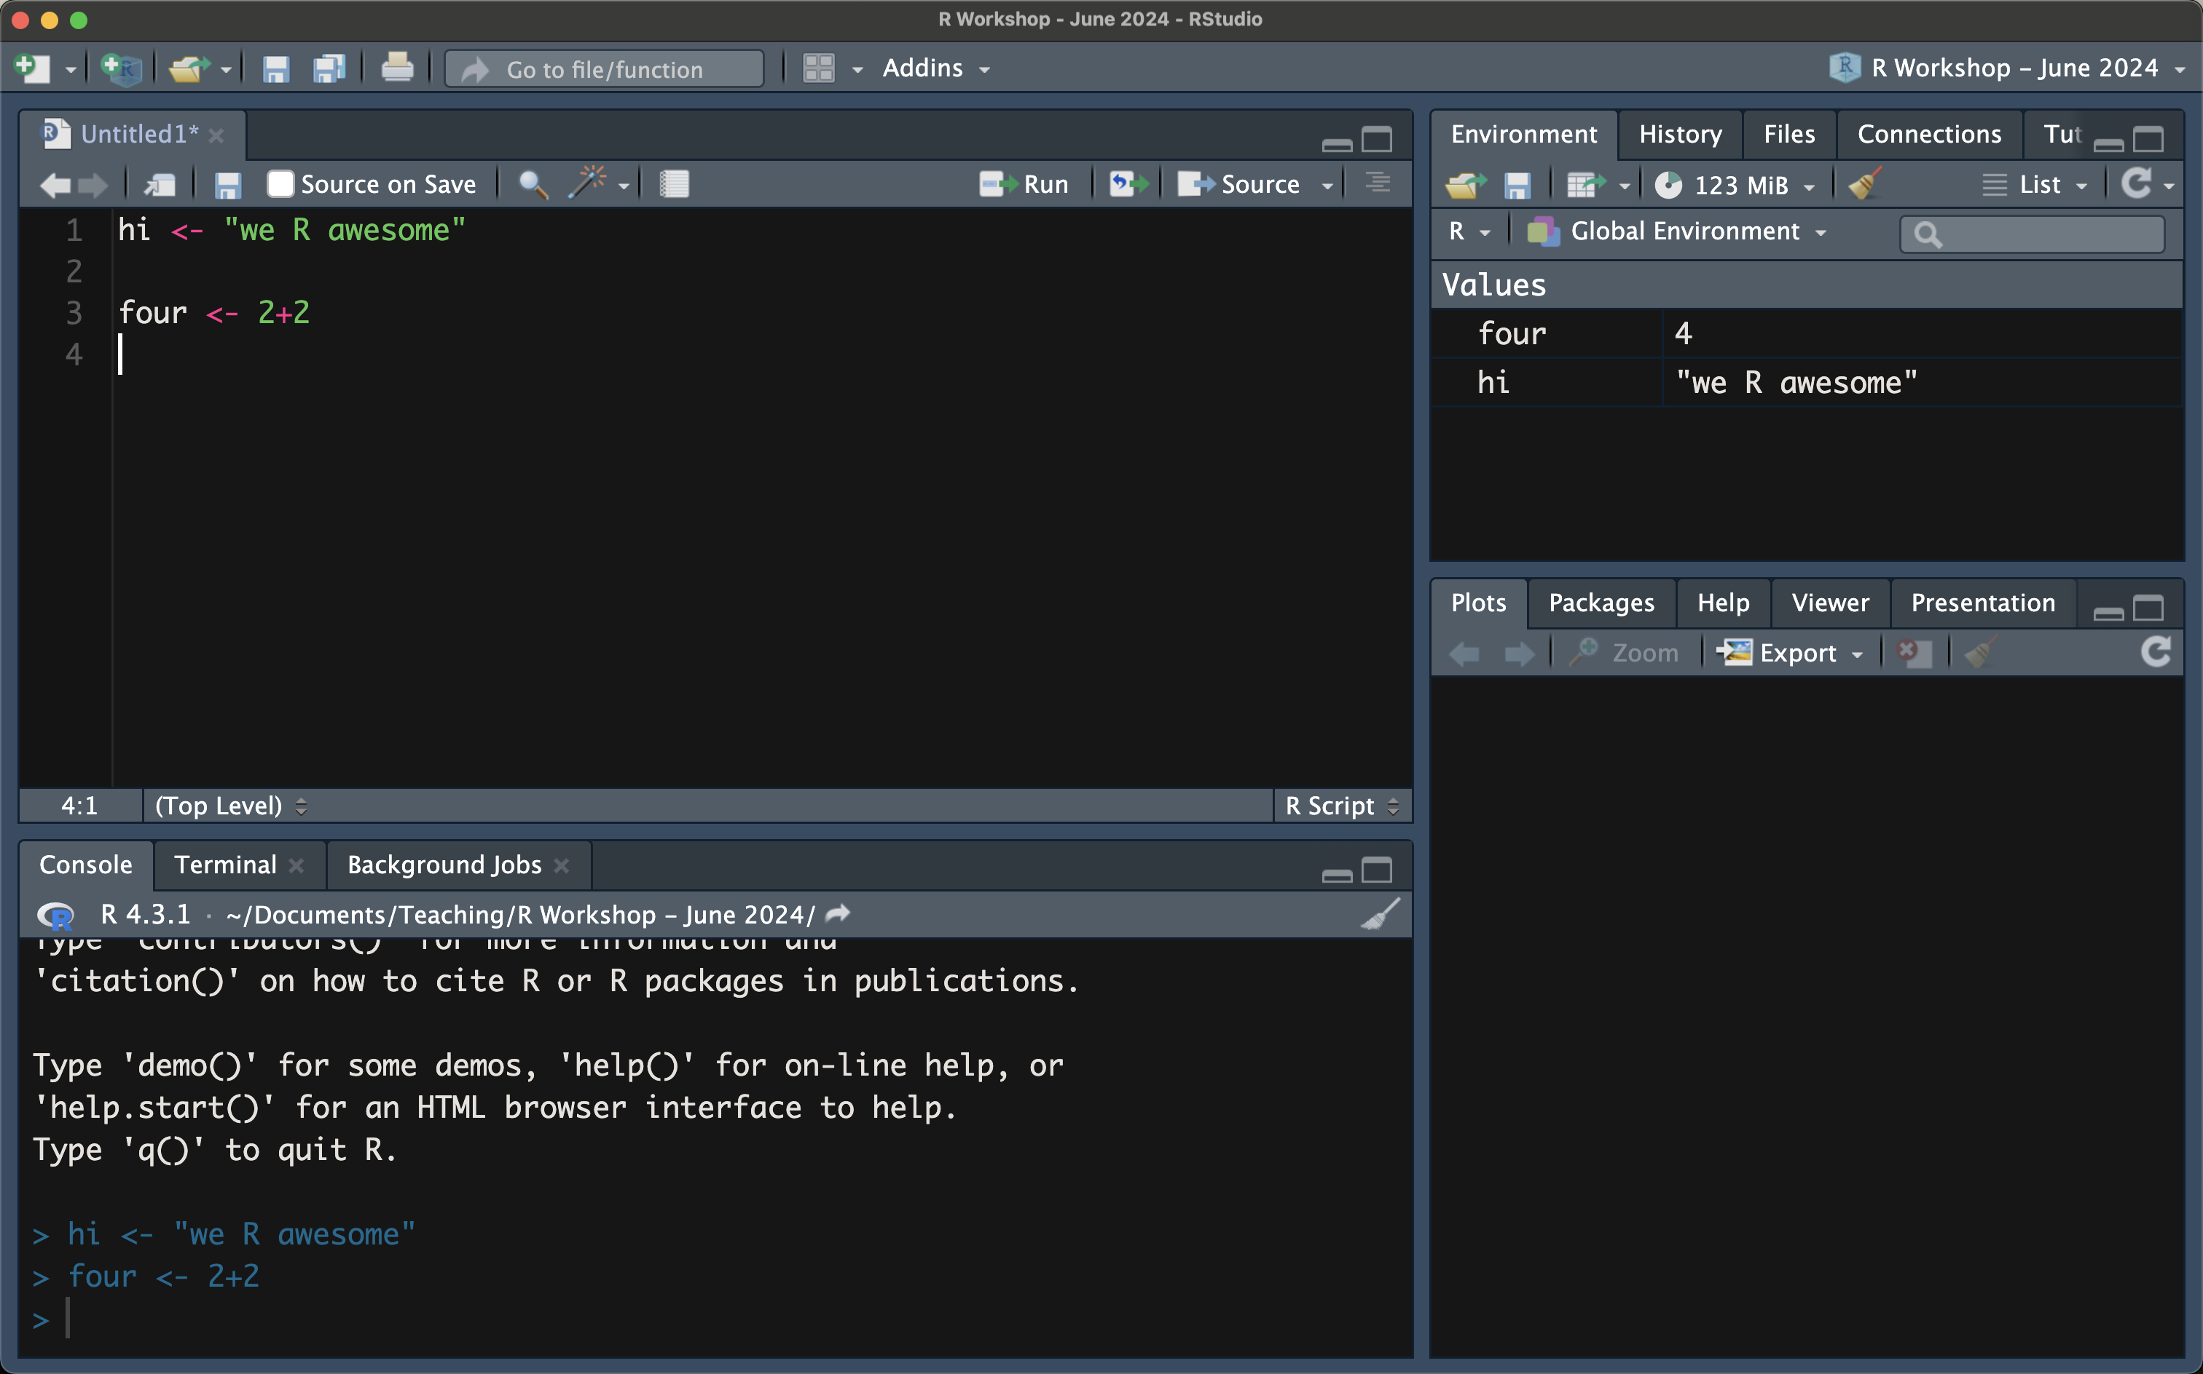
environment
displays variables and their values

Slide 8
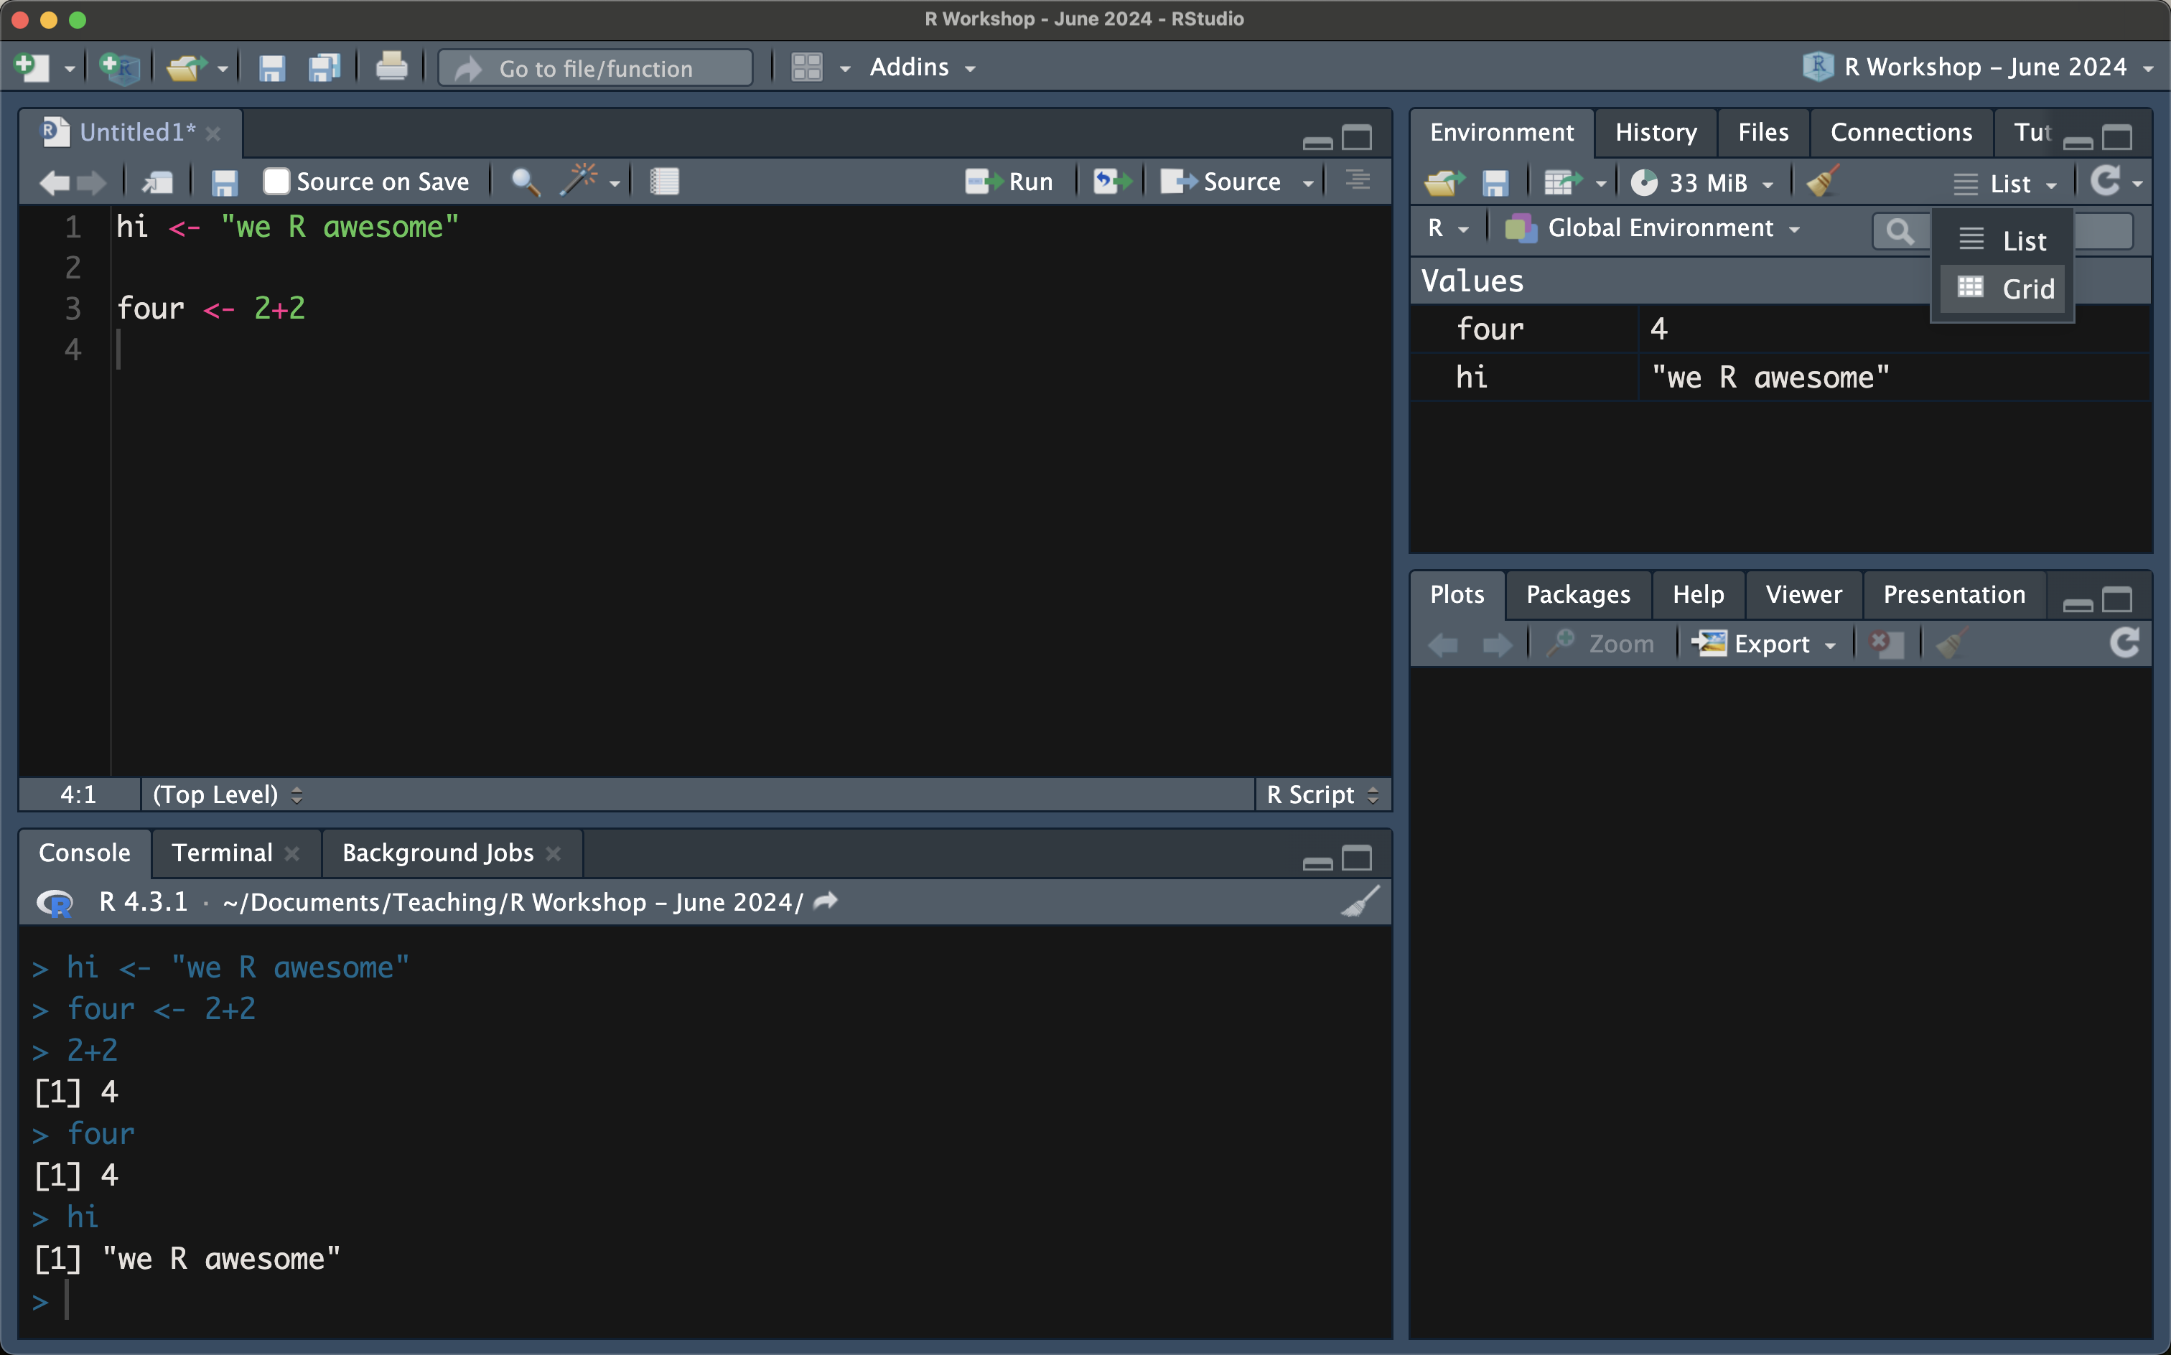
environment
displays variables and their values
easily remove unwanted variables (shift to grid view)

Slide 9
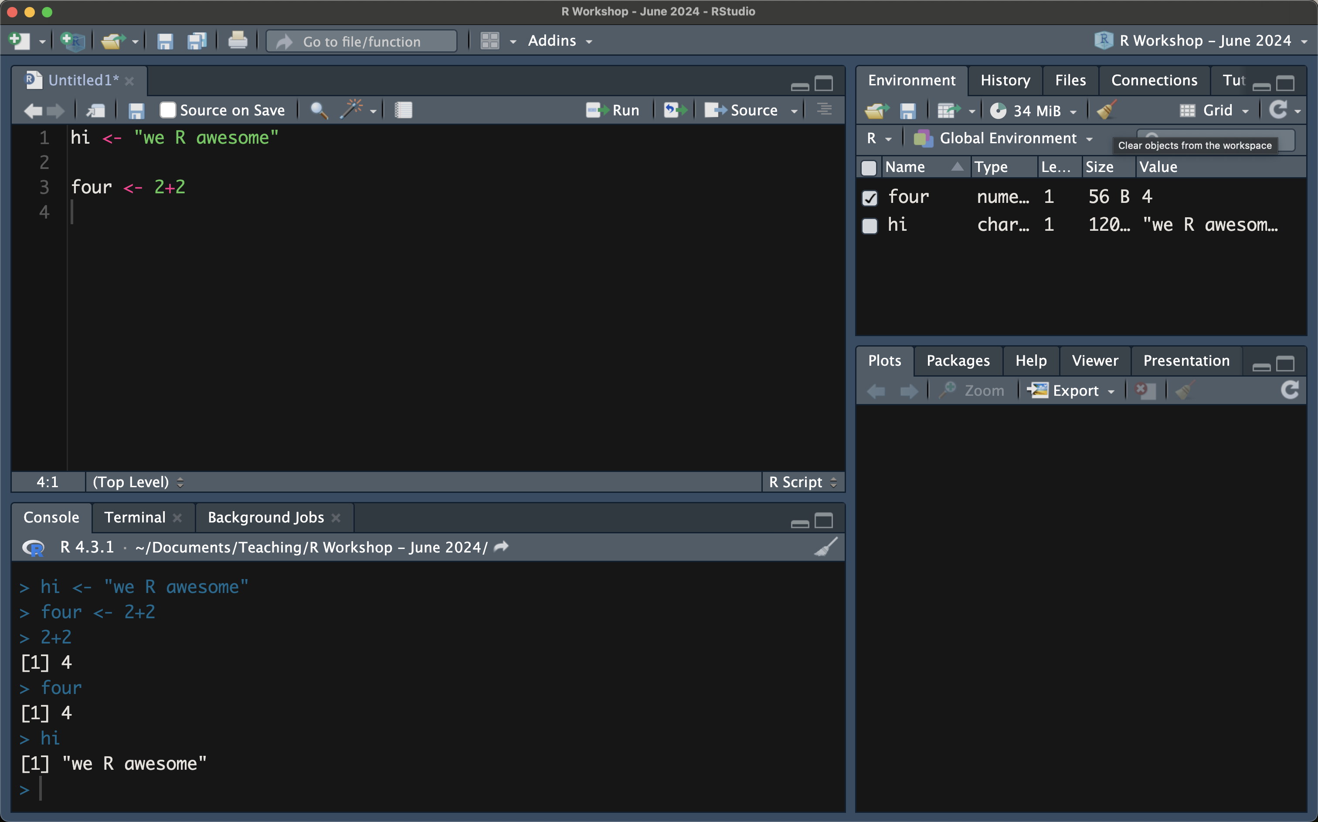
environment
displays variables and their values
easily remove unwanted variables (shift to grid view)

Slide 10
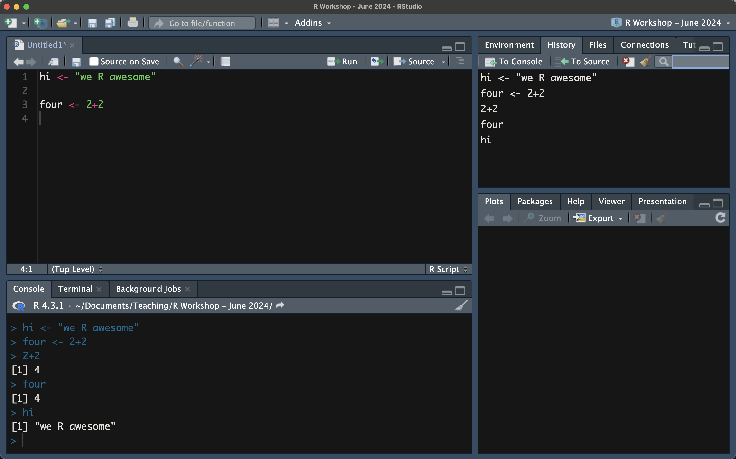
environment
displays variables and their values
easily remove unwanted variables (shift to grid view)
History: keep track of the commands + operations that have been run (also available in the console)

Slide 11

console
shows lines run from the script
all the same things you can do in a dedicated script
on-the-fly programming
BUT it doesn’t save for future use!

Slide 12
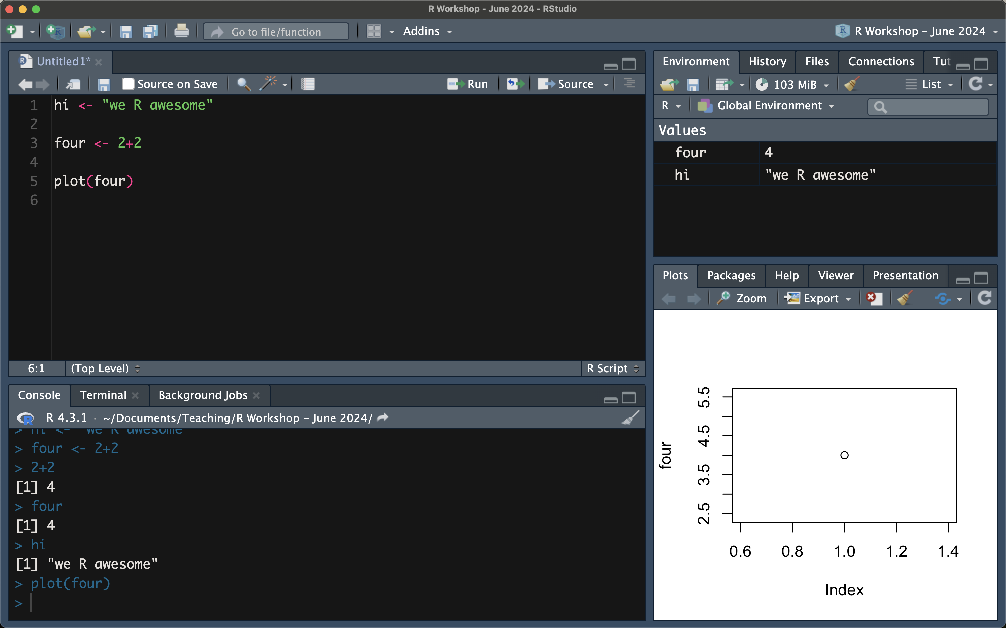
viewer etc.
displays figures/plots

Slide 13
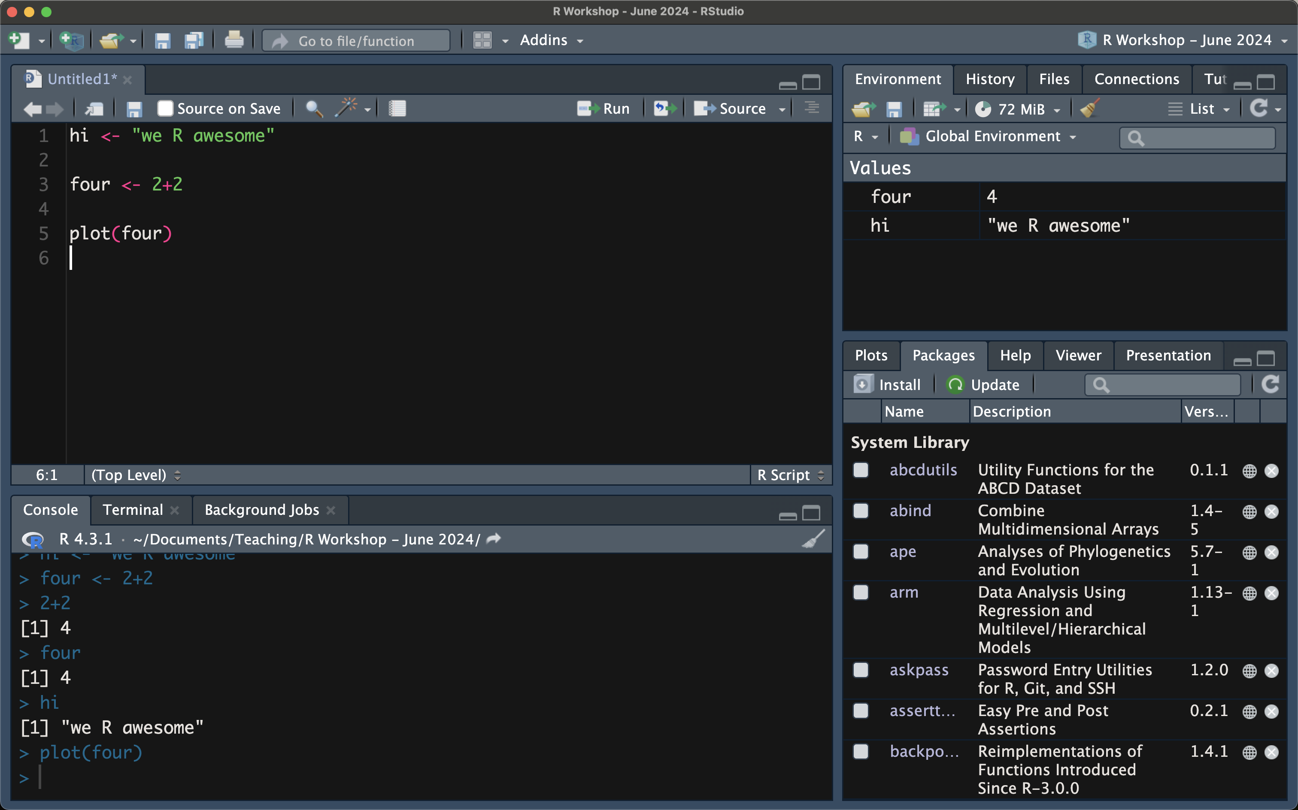
viewer etc.
displays figures/plots
Packages: lists all the installed packages; check the box to “load” a package

Slide 14
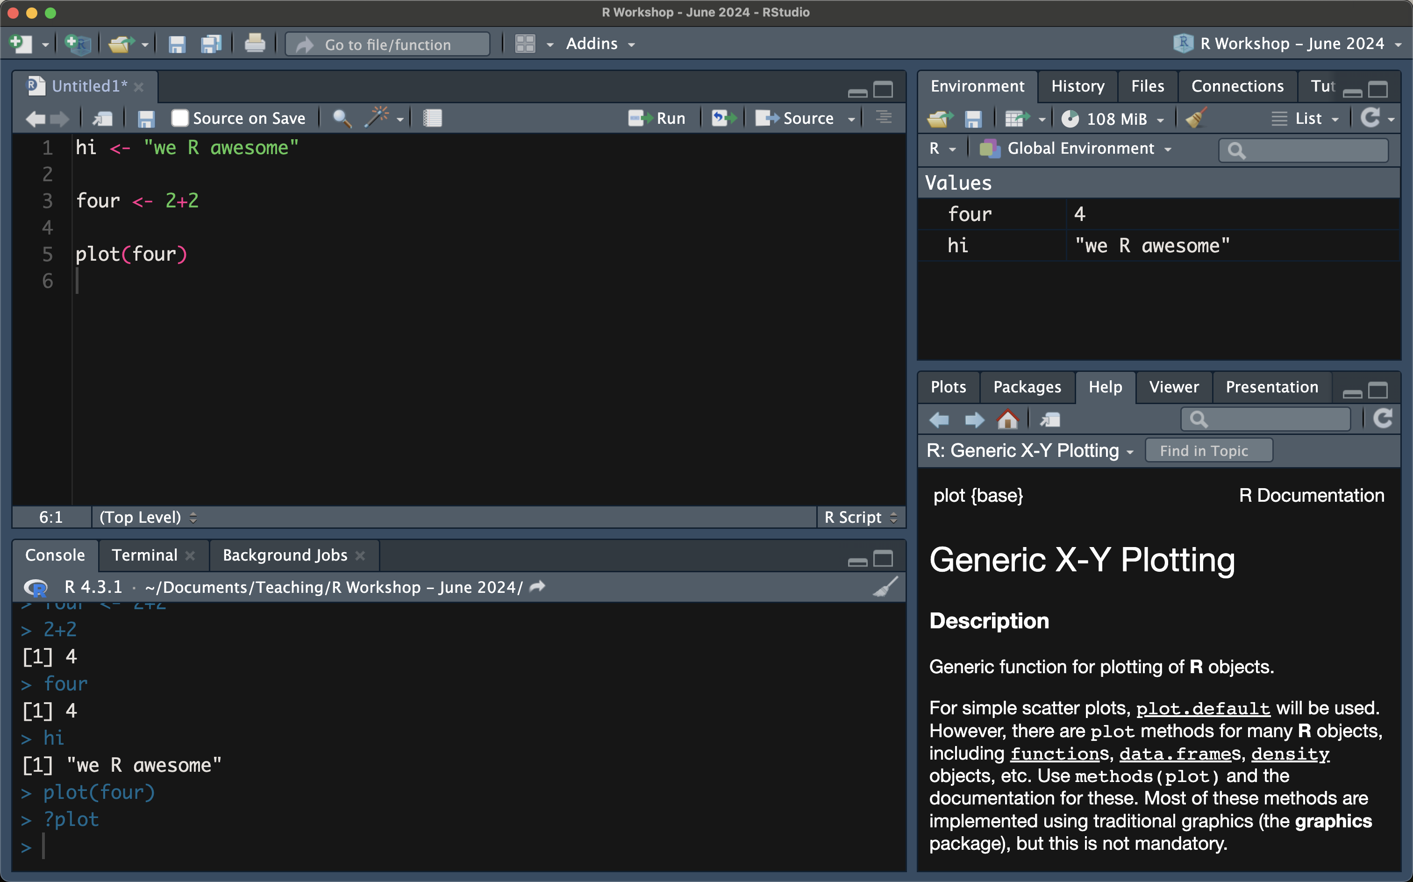
viewer etc.
displays figures/plots
Packages: lists all the installed packages; check the box to “load” a package
Help: documentation for packages and functions

Slide 15
script/editor
environment
install + load packages
perform operations, create variables, create objects
write functions, loops
import and export data
data exploration, cleaning, analysis, and visualization
displays variables and their values
easily remove unwanted variables (shift to grid view)
History: keep track of the commands + operations that have been run (also available in the console)
console
viewer etc.
shows lines run from the script
all the same things you can do in a dedicated script
on-the-fly programming
BUT it doesn’t save for future use!
displays figures/plots
Packages: lists all the installed packages; check the box to “load” a package
Help: documentation for packages and functions

Slide 16
Scripting in R Studio
Installing + loading packages
Shortcuts
Data types
Assigning variables
Basic operations and functions

Slide 17
R Packages
Collections of functions and datasets in a standardized format.
Similar to libraries in Python.
Many packages are developed by users in the community.
Packages only need to be installed once.
install.packages(“package”)
Packages must be loaded each time you open R-Studio.
library(package)
Commonly used packages include: ggplot2, dplyr, psych, stats, tidyr, readr
Many of these are encompassed within the tidyverse package (more in Session 2)
Notes:
Most of R scripting can be performed in base R i.e., the basic R language; packages are developed on top of this base R, usually to make the workflow more efficient

Slide 18
Basic commands
Get the current working directory getwd()
List the files in the directory
Console vs GUI list.files() or dir()
Change the working directory setwd()
See documentation for functions/packages ?function()
Read in data read.csv()
Check variable class/type class()
Comments # add comment

Slide 19
Shortcuts
Cmd/Ctrl+Enter: runs the current line or selected code; moves on to the next line when complete.
Option+Enter: runs the current line or selected code; stays on the same line when complete.
(console) up arrow key: scroll through previously run code; code appears in reverse chronological order.
Tab autocomplete: autocompletes or provides a partial list of stored objects/variables when you start typing in a variable name and press Tab.
?function: pulls up the documentation for a given function.

Slide 20
Common data types and objects
Character “Letters”, “123”
Numeric 1, -2, 1.1, 0.0005
Integer -1L, 0L, 1L, 2L
Logical/Boolean TRUE, FALSE
Vectors c()
Lists list()
Matrices matrix()
Data frames data.frame()
Factors factor()
Notes:
Characters – as long as the quotes are present, information will be treated as character
Can put anything inside these objects

Slide 21
Assigning variables
It is useful to save the output of a function/operation into a variable that can be used later.
Use <- to assign values to variables.

Slide 22
Basic operations and functions
Arithmetic operations
Manual (2+3+4)/3
Using functions mean(c(2,3,4))
Relational operations
Output is logical (TRUE or FALSE)
Greater than/less than/equal to 5 > 10; 5 < 10; 5 == 10
Logical operations
Output is logical (TRUE or FALSE)
If both conditions are true TRUE & TRUE
If any of the conditions are true TRUE | FALSE
Notes:
Give examples of when the logical operations might be useful (e.g., if you have a dataset where you want to filter patients who have diabetes AND are smokers)

Slide 23
Importing and exploring data
Text files
my_text_file <- read.delim(“path/to/filename”, header = TRUE/FALSE)
CSV files
my_csv_file <- read.csv(“path/to/ filename”, header = TRUE/FALSE, sep = “,”)
Quick & easy ways to see object attributes
str(dataframe)
names(dataframe)
summary(dataframe)

Slide 24
Upcoming R Workshops
Tuesday September 17: Data Exploration and Visualization
Tuesday September 21: Statistical Testing in R
Correlations
T-tests
Linear regressions

